Slide 1
Taj Mahal Design
Using By AutoCad

Slide 2
Submitted By
Pankaj Mahanto
ID:213902002
Mostak Ahamed
ID:213902126
Submitted To
Rusmita Halim Chaity
Lecturer, Department of CSE
Green University of Bangladesh

Slide 3
Introduction
Historical significance
The project aims to safeguard the monument’s
Taj Mahal's beauty while preserving
Cultural heritage.

Slide 4
Objectives
Accurate Replication
Symmetrical Layout
Detailed Modeling
Material Selection and Visualization
Design Optimization and Iteration

Slide 5
Project Description
The project involves the digital design and visualization of a custom Taj Mahal-inspired structure using AutoCAD software. The objective is to create a unique architectural design that incorporates elements inspired by the Taj Mahal while incorporating modern aesthetics. The project includes conceptualization, detailed design development, and visualization of the structure.

Slide 6
Tool/Equipment
List Of Tool
Precise Drafting
3D Modeling
Material Selection
Lighting and Visualization
Detailed Documentation
Textures

Slide 7
Tool/Equipment
List Of Command
Line, Rec, Circle, Polygon, Trim, Offset
Extrude, Press-Pull, Revolve
UCS Selection
Lighting and Visualization
Detailed Documentation

Slide 8
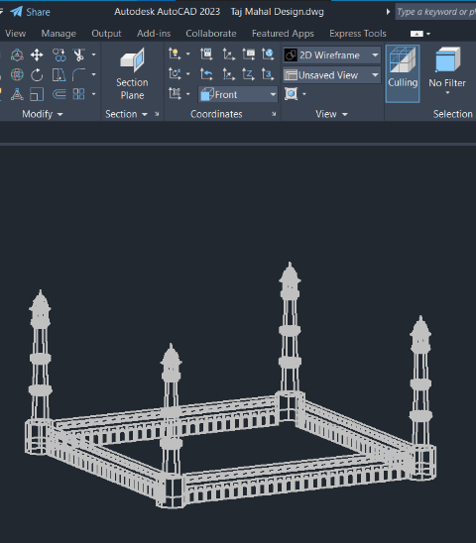
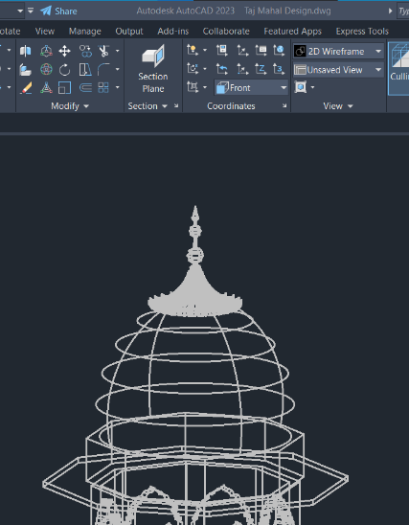
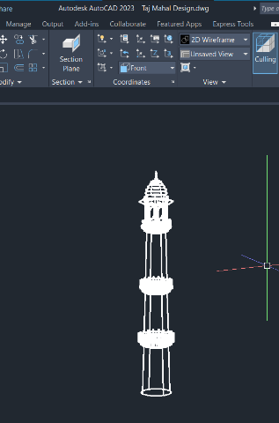
Implementation
Figure:-Miner 2D
Figure:-Base 2D
Figure:-Doom 2D

Slide 9
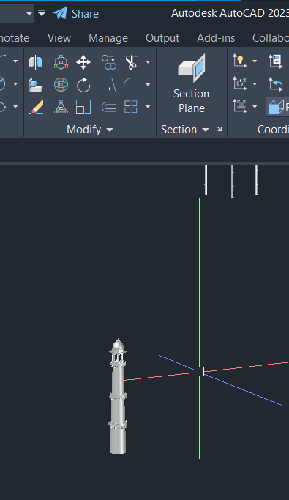
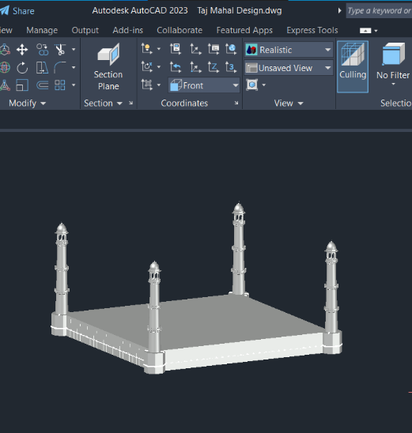
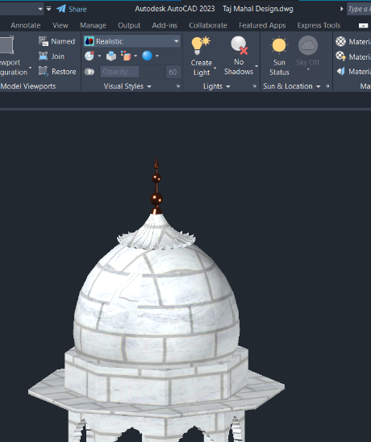
Implementation
Figure:-Miner
Figure:-Base
Figure:-Doom

Slide 10
Output
Figure:-Miner
Figure:-Base
Figure:-Doom

Slide 11
Thank You

